Slide 1

Statistical Analysis of Structural MRI Data
John Muschelli, Elizabeth Sweeney, Russell Shinohara, Ani Eloyan and Ciprian Crainiceanu
Biostatistics Department
The Johns Hopkins Bloomberg School of Public Health
Baltimore, MD
March 2015, ENAR Workshop on Neuroimaging Data Analysis
http://www.smart-stats.org

Slide 2

Setup
Notes:
FLAIR – pulse sequence that nulls fluids (such as csf) – good for viewing periventricular lesions
T2 –w – fat shows darker, water shows lighter
PD – spin density (or proton density)
T1-w good contrast between white and dark matter

Slide 3
Before the course begins…
Install MIPAV (http://mipav.cit.nih.gov)
Install R (http://cran.r-project.org)
Install R Studio (http://www.rstudio.com)
Open R Studio and install devtools package in R
install.packages('devtools')
library(devtools)
install_github('muschellij2/ENARSC2015')
Setup

Slide 4
Once ENARSC2015 installed, run
library(ENARSC2015)
copy_data(OUTPUTDIRECTORY)
# where OUTPUTDIRECTORY is the output directory you want data to be copied to
# all analysis will be done in this directory
Setup

Slide 5
Course Deliverables
Notes:
FLAIR – pulse sequence that nulls fluids (such as csf) – good for viewing periventricular lesions
T2 –w – fat shows darker, water shows lighter
PD – spin density (or proton density)
T1-w good contrast between white and dark matter

Slide 6
Course Deliverables
Knowledge of R and MIPAV
Interactively explore data with the imaging software Medical Image Processing, Analysis, and Visualization (MIPAV)
Image preprocessing with MIPAV
Reading, writing, plotting and manipulation of imaging data in R
Deliverable

Slide 7
Subtract two images
Subtract the a follow-up T1-w volume from a baseline T1-w volume.
-
=
Deliverables

Slide 8
Template-Based Analysis
Warped FLAIR image
Warped ROI image
MNI T1 Template
Deliverables

Slide 9
Outline
Structural MRI Data
Public MRI Data
Opening Images in R
Image Preprocessing
Image Pre-processing in MIPAV
fslr and ANTsR: R packages for Image preprocessing
Image Analysis in R
Notes:
FLAIR – pulse sequence that nulls fluids (such as csf) – good for viewing periventricular lesions
T2 –w – fat shows darker, water shows lighter
PD – spin density (or proton density)
T1-w good contrast between white and dark matter

Slide 10
Structural MRI Data
Notes:
FLAIR – pulse sequence that nulls fluids (such as csf) – good for viewing periventricular lesions
T2 –w – fat shows darker, water shows lighter
PD – spin density (or proton density)
T1-w good contrast between white and dark matter

Slide 11
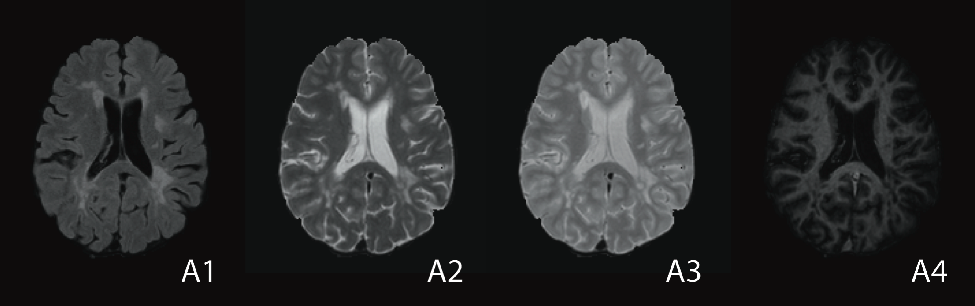
What are structural MRIs?
A1. Fluid-attenuated inversion recovery (FLAIR)
A2. T2-weighted (T2-w)
A3. Proton density (PD)
A4. T1-weighted (T1-w)
Structural MRI
Notes:
FLAIR – pulse sequence that nulls fluids (such as csf) – good for viewing periventricular lesions
T2 –w – fat shows darker, water shows lighter
PD – spin density (or proton density)
T1-w good contrast between white and dark matter

Slide 12
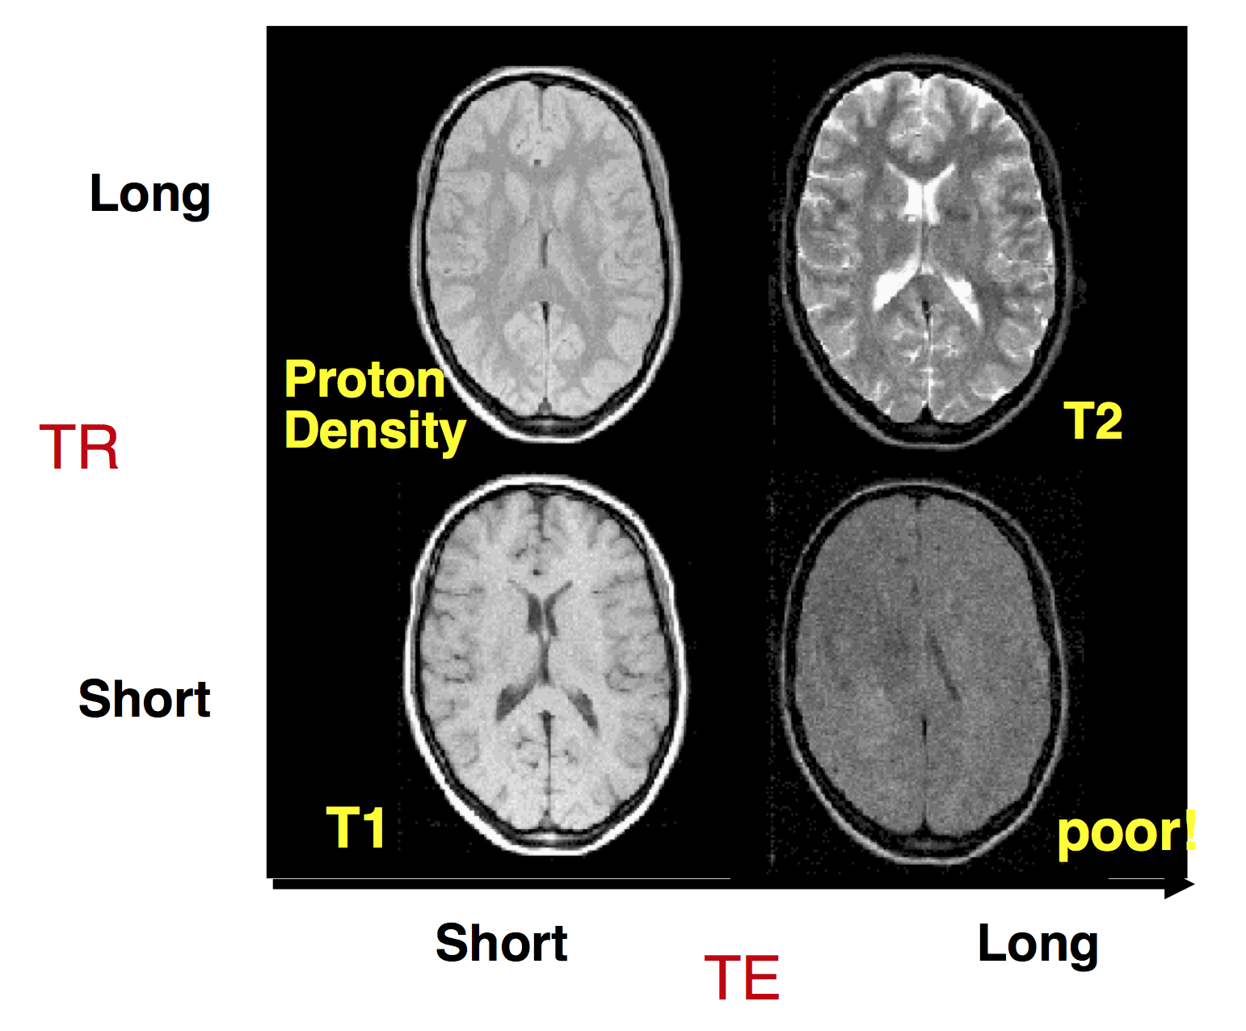
MRI Signal Intensities
Structural MRI
Slide borrowed with permission from Martin Lindquist
Notes:
FLAIR – pulse sequence that nulls fluids (such as csf) – good for viewing periventricular lesions
T2 –w – fat shows darker, water shows lighter
PD – spin density (or proton density)
T1-w good contrast between white and dark matter

Slide 13
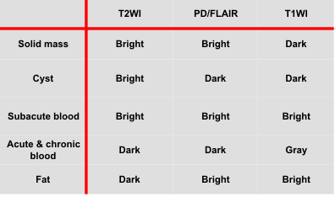
MRI Signal Intensities
Structural MRI
Notes:
FLAIR – pulse sequence that nulls fluids (such as csf) – good for viewing periventricular lesions
T2 –w – fat shows darker, water shows lighter
PD – spin density (or proton density)
T1-w good contrast between white and dark matter

Slide 14
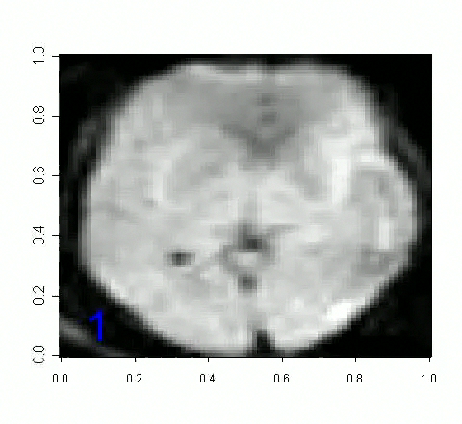
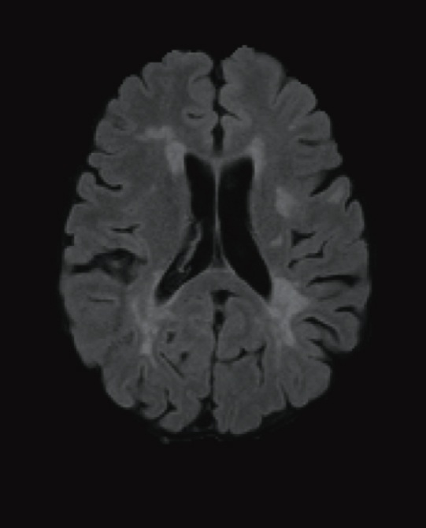
Structural MRI vs. fMRI
Structural MRI

Slide 15
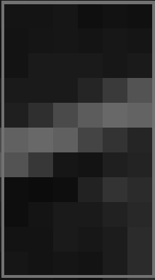
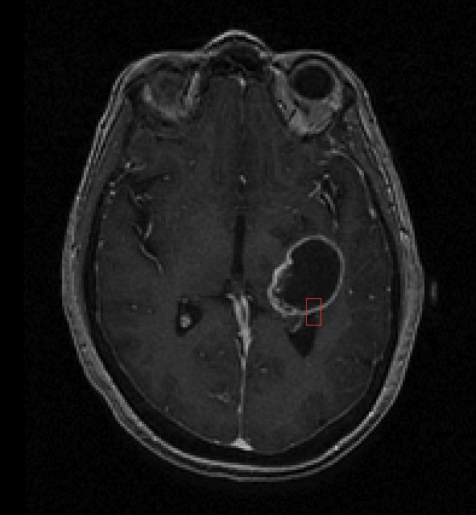
The Structure of Structural MRI
Structural MRI
Notes:
T1-w post gad

Slide 16
The Structure of Structural MRI
Structural MRI

Slide 17
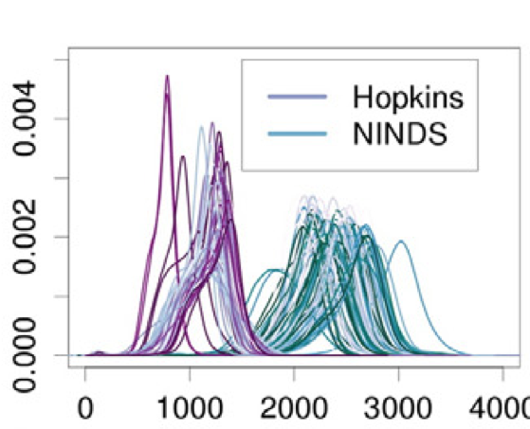
Arbitrary Units?!?!
Structural MRI

Slide 18
180 x 216 = 38,800 voxels

Slide 19
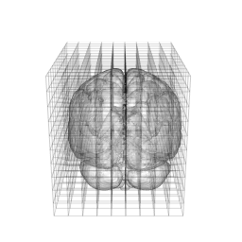
Figure created in the R package brainR
180 x 180 x 216 ≈ 7 million voxels

Slide 20
4 x 7million = 28 million voxels

Slide 21
131 x 28 million > 3.6 billion voxels

Slide 22
Public MRI Data
Notes:
FLAIR – pulse sequence that nulls fluids (such as csf) – good for viewing periventricular lesions
T2 –w – fat shows darker, water shows lighter
PD – spin density (or proton density)
T1-w good contrast between white and dark matter

Slide 23
Public Structural MRI Datasets
Neuroimaging Informatics Tools and Resources Clearinghouse (NITRC) Home to many open source neuroimaging datasets, software tools, and much more (www.nitrc.org)
Alzheimer’s Disease Neuroimaging Initiative (ADNI) over 1500 subjects with multi-modal MRI; cognitively normal older individuals, individuals with mild cognitive impairment, or individuals with Alzheimer's disease (adni.loni.ucla.edu/data-samples/access-data)
Open Access Series of Imaging Studies (OASIS) T1-weighted volumes from 416 subjects with Alzheimer’s disease (www.oasis-brains.org)
OsiriX A number of open source DICOM imaging datasets of various parts of the body (www.osirix-viewer.com/datasets/)
Human Connectome Project Structural MRI data as well as resting-state and task-evoked functional MRI, and diffusion imaging. (http://www.humanconnectome.org)
Structural MRI

Slide 24
Using Data From
Neuroimaging Informatics Tools and Resources Clearinghouse (NITRC) Home to many open source neuroimaging datasets, software tools, and much more (www.nitrc.org)
Alzheimer’s Disease Neuroimaging Initiative (ADNI) over 1500 subjects with multi-modal MRI; cognitively normal older individuals, individuals with mild cognitive impairment, or individuals with Alzheimer's disease (adni.loni.ucla.edu/data-samples/access-data)
Open Access Series of Imaging Studies (OASIS) T1-weighted volumes from 416 subjects with Alzheimer’s disease (www.oasis-brains.org)
OsiriX A number of open source DICOM imaging datasets of various parts of the body (www.osirix-viewer.com/datasets/)
Human Connectome Project Structural MRI data as well as resting-state and task-evoked functional MRI, and diffusion imaging. (http://www.humanconnectome.org)
Structural MRI

Slide 25
Let’s work in R for a bit
Check out ENAR_Tutorial.Rmd in the vignettes folder
Notes:
FLAIR – pulse sequence that nulls fluids (such as csf) – good for viewing periventricular lesions
T2 –w – fat shows darker, water shows lighter
PD – spin density (or proton density)
T1-w good contrast between white and dark matter

Slide 26
Subtract two images
Subtract the a follow-up T1-w volume from a baseline T1-w volume.
-
=
Deliverables

Slide 27
Image Preprocessing
Preprocessing
Notes:
FLAIR – pulse sequence that nulls fluids (such as csf) – good for viewing periventricular lesions
T2 –w – fat shows darker, water shows lighter
PD – spin density (or proton density)
T1-w good contrast between white and dark matter

Slide 28
Image Preprocessing
Preprocessing
Notes:
Why do we use MIPAV?

Slide 29
File types
Preprocessing
Notes:
Why do we use MIPAV?

Slide 30
DICOM
Most MRI scanners save their reconstructed data to a file format called DICOM (Digital Imaging and Communications in Medicine).
The data is generally stored slice-wise and contains large amount of meta-data about image acquisition and subject.
Although DICOM is the standard format for outputting data from the MRI scanner, it is necessary to convert to other formats before data analysis
Preprocessing
Slide borrowed with permission from Martin Lindquist

Slide 31
Analyze
The Analyze file format originates from the Analyze software package.
It stores each data set in two separate files.
The first is the data file (with extension .img), which contains the binary data.
The second is the header file (with extension .hdr), which contains the meta-data.
Preprocessing
Slide borrowed with permission from Martin Lindquist

Slide 32
NIfTI
NIfTi (Neuroimaging Informatics Technology Initiative) is a file format designed to promote compatibility among programs using fMRI data sets.
Extends Analyze by storing more meta-data (e.g., affine matrices, data arrangement, slice order information).
Comes in two formats, a format with combined header and data (extension .nii), and a format that uses the same extensions as Analyze (extension .hdr/.img).
Contains a complete description of the data orientation, eliminating flipping problems almost entirely.
Preprocessing
Slide borrowed with permission from Martin Lindquist

Slide 33
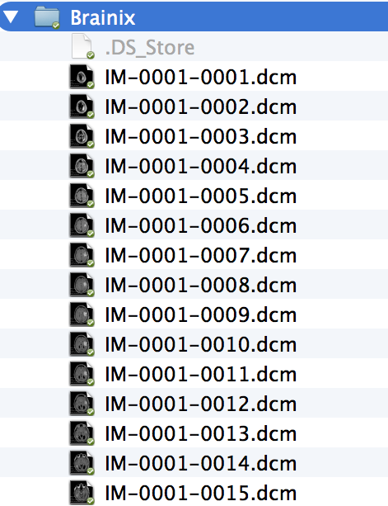
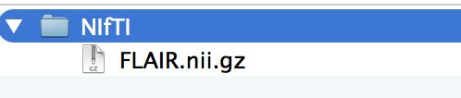
File types
DICOM
NIfTI
Preprocessing

Slide 34
Crossing the Thin Purple Line
dcm2nii (http://www.mccauslandcenter.sc.edu/mricro/mricron/dcm2nii.html)
R Package oro.dicom (http://cran.r-project.org/web/packages/oro.dicom/index.html)
(There is a vignette DICOM_to_NIfTI in ENARSC2015)
…
Preprocessing

Slide 35
Preprocessing Pipeline
Notes:
Why do we use MIPAV?

Slide 36
Preprocessing

Slide 37
N3 correction is a type of intensity inhomogeneity correction. MRI intensity inhomogeneity is the slow variation of intensities within a tissue class in an image.
Preprocessing

Slide 38
Preprocessing

Slide 39
Skull-stripping removes extra-cerebral voxels from the volume.
Preprocessing

Slide 40
Preprocessing

Slide 41
Coregister volumes from different modalities to one another (for example register the FLAIR to the T1-w volume or registering a baseline to a follow-up study).
Preprocessing

Slide 42
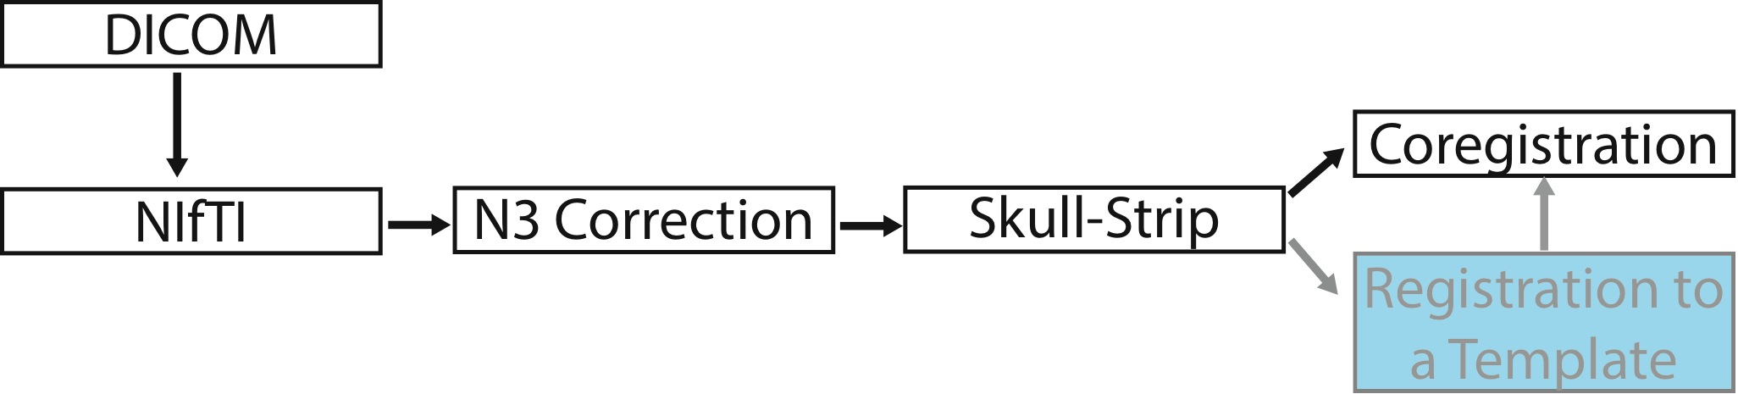
You can also register to a group template (such as the MNI T1-w template)
Preprocessing

Slide 43
Registration
Registration is a transformation of v to T(v)
Preprocessing

Slide 44
Linear Registration: Rigid
Rigid registration has 6 degrees of freedom and consists of a translation and a rotation.
Rotation Matrix
Translation vector
Preprocessing

Slide 45
Linear Registration: Affine
Affine registration has 12 degrees of freedom. It takes the same form as rigid registration, but the matrix A is not constrained to be a rotation matrix
Preprocessing

Slide 46
Nonlinear Registration
Allows for registration to a template or from one subject to another
Preprocessing

Slide 47
Image Pre-processing in Medical Image Processing, Analysis, and Visualization (MIPAV)
Notes:
Why do we use MIPAV?

Slide 48
Image Pre-processing in MIPAV
http://www.youtube.com/user/MIPAVvideos
Install MIPAV (http://mipav.cit.nih.gov)
http://www.youtube.com/watch?v=npSYWYJa530
Visualization in MIPAV
http://www.youtube.com/watch?v=02vUrfSaGWE
Run N3 Correct and Co-register Images in MIPAV
http://www.youtube.com/watch?v=uCr-Zlxu454
Save!
http://www.youtube.com/watch?v=Zfh5nKITbkA
Preprocessing

Slide 49
Open an Image in MIPAV
Open MIPAV
File >> Open image (A) from the folder you copied the data into (Open file names SUBJ0001-01-MPRAGE.nii.gz)
Preprocessing

Slide 50
N3-Inhomogenity Correction
(Select SUBJ0001-01-MPRAGE.nii.gz)
Algorithms>> Shading correction >> Inhomogeneity N3 Correction
(Leave default parameters, Press OK)
File >> Save image as >> (Save image as SUBJ0001-01-MPRAGE_N3.nii.gz)
File >> Open image (A) from disk (Open file names SUBJ0001-02-MPRAGE.nii.gz)
(Repeat N3-Inhomogenity Correction for SUBJ0001-02-MPRAGE.nii.gz)
Preprocessing

Slide 51
Registration
(Select the N3 Corrected image of SUBJ0001-02-MPRAGE.nii.gz)
Algorithms >> Registration >> Optimized Automatic Registration
(Change Input Options
Register to: SUBJ0001-01-MPRAGE.nii.gz
Degrees of Freedom: Rigid – 6)
File >> Save image as >> (SUBJ0001-02-MPRAGE_N3_REG.nii.gz)
Preprocessing

Slide 52
fslr and ANTsR: R packages for Image preprocessing
Notes:
Why do we use MIPAV?

Slide 53
fslr: an FSL port to R
FSL is useful, open-source, scriptable software for neuroimaging analysis
(http://fsl.fmrib.ox.ac.uk/fsl/fslwiki/)
Problem: Requires coding in bash
Solution: fslr
Ports many of the main functions of FSL into R
Disclaimer: May not work on windows
Preprocessing

Slide 54
Main contribution: work with nifiti objects in R, pass them in as arguments in fslr functions, return nifti objects back out to R
R nifti object
fslr function
R nifti object
Write .nii to disk
Preprocessing

Slide 55
fslr help
Available on R CRAN
Each fslr function has help files as usual
help(package=“fslr”)
Each fslcmd should have a fslcmd.help file that prints out the help from FSL
fslmaths.help
Preprocessing

Slide 56
ANTsR: an ANTs port to R
Advanced Normalization Tools (ANTs)
(http://picsl.upenn.edu/software/ants/) is a state-of-the-art medical image registration and segmentation toolkit
ANTsR (http://stnava.github.io/ANTsR/) is a package that ports ANTs functions in R
Available on github (https://github.com/stnava/ANTsR)
Preprocessing

Slide 57
Confused?
Check out the presentation folder
ANTsR_pipeline.Rmd
fsl_pipeline.Rmd
Preprocessing

Slide 58
Image Analysis in R
Check out ENAR_Tutorial.Rmd in the vignettes folder
Notes:
FLAIR – pulse sequence that nulls fluids (such as csf) – good for viewing periventricular lesions
T2 –w – fat shows darker, water shows lighter
PD – spin density (or proton density)
T1-w good contrast between white and dark matter

Slide 59
Going to the Numbers Structural MRI Analysis in R
R has a medical imaging task view with other imaging-related R packages:
http://cran.r-project.org/web/views/MedicalImaging.html
Resources for the oro.nifti package:
http://cran.r-project.org/web/packages/oro.nifti/vignettes/nifti.pdf
We blog about imaging at times:
http://elizabethmargaretsweeney.wordpress.com/ (Elizabeth’s blog)
http://hopstat.wordpress.com/ (John’s blog)
http://bmorebiostat.com
Statistical Analysis

